Slide 1

REACH receiver and calibration pipeline
Nima Razavi-Ghods, Ian Roque, Will Handley, Steve Carey, Tian Huang, John Ely

Slide 2
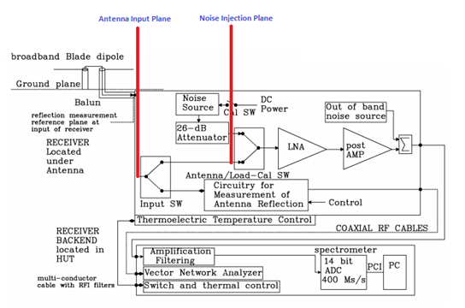
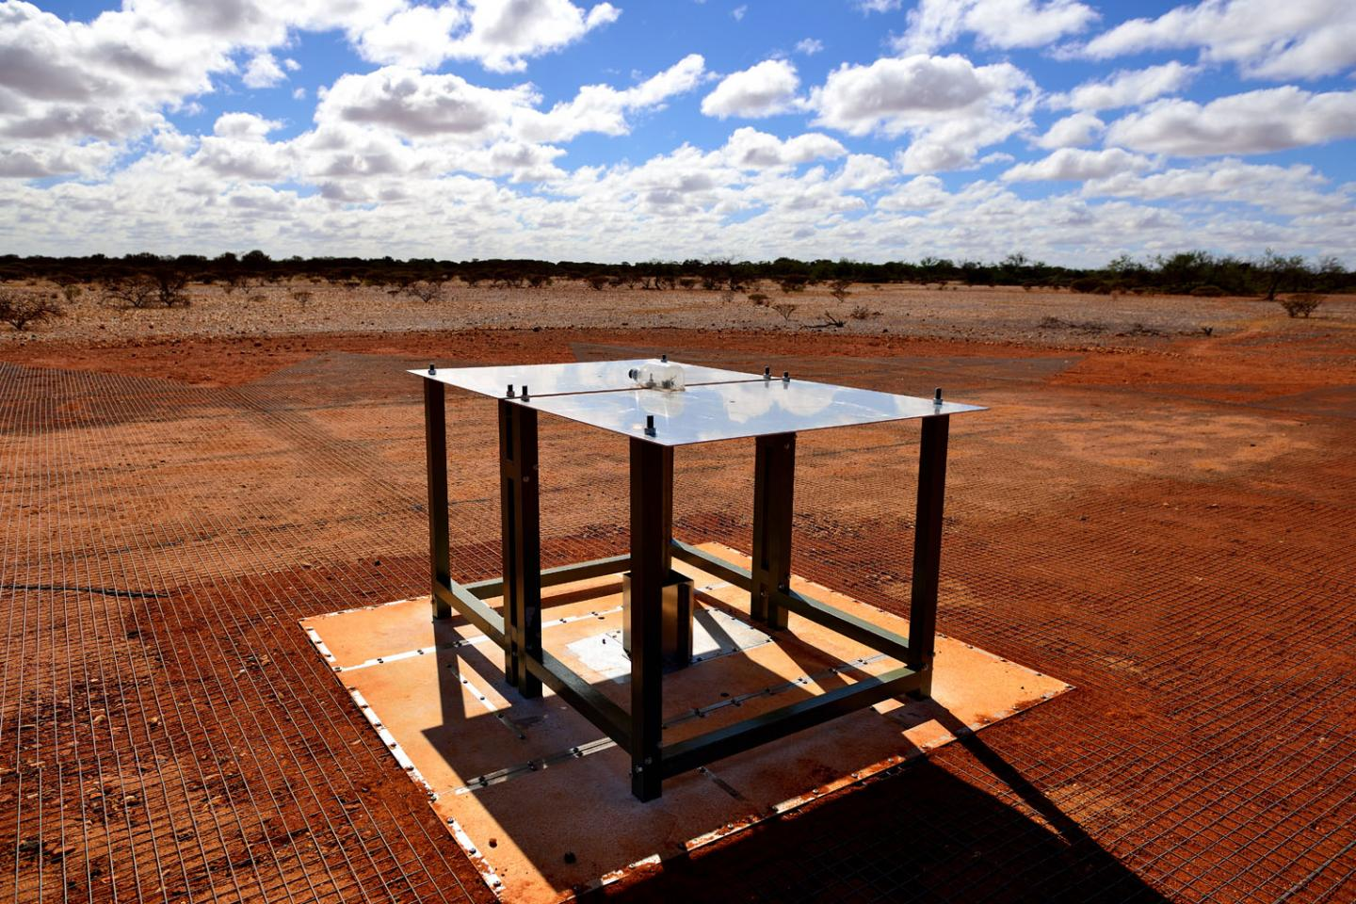
EDGES Receiver
Relies on the noise waves formalism introduced by Meys (1978)
Uses Dicke switching to characterize imperfect impedance matching between the antenna and receiver
This mismatch can mean 10s of Kelvin variation in the measured temperature
Not implemented for any other global experiment including LEDA and SARAS
For EDGES only antenna impedance is measured in the field but most necessary parameters are measured in the lab
Out of band noise injected for ADC cal
Temperature is kept constant using a PID controller

Slide 3
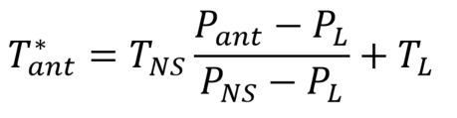
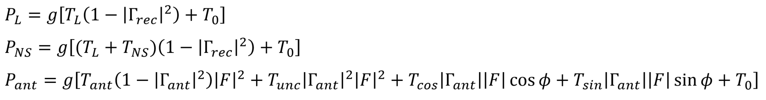
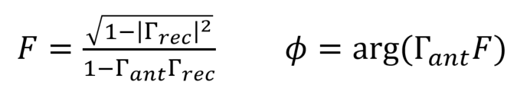
EDGES calibration formalism
The “uncalibrated” antenna temperature is formed by
here each spectra can be described as the following instrument responses including the noise wave parameters Tunc, Tcos, and Tsin
given

Slide 4
Main calibration equation
EDGES computes these calibration parameters in an iterative way. Use hot and cold standards to determine scale and offset and cable open and short to determine frequency behaviour

Slide 5
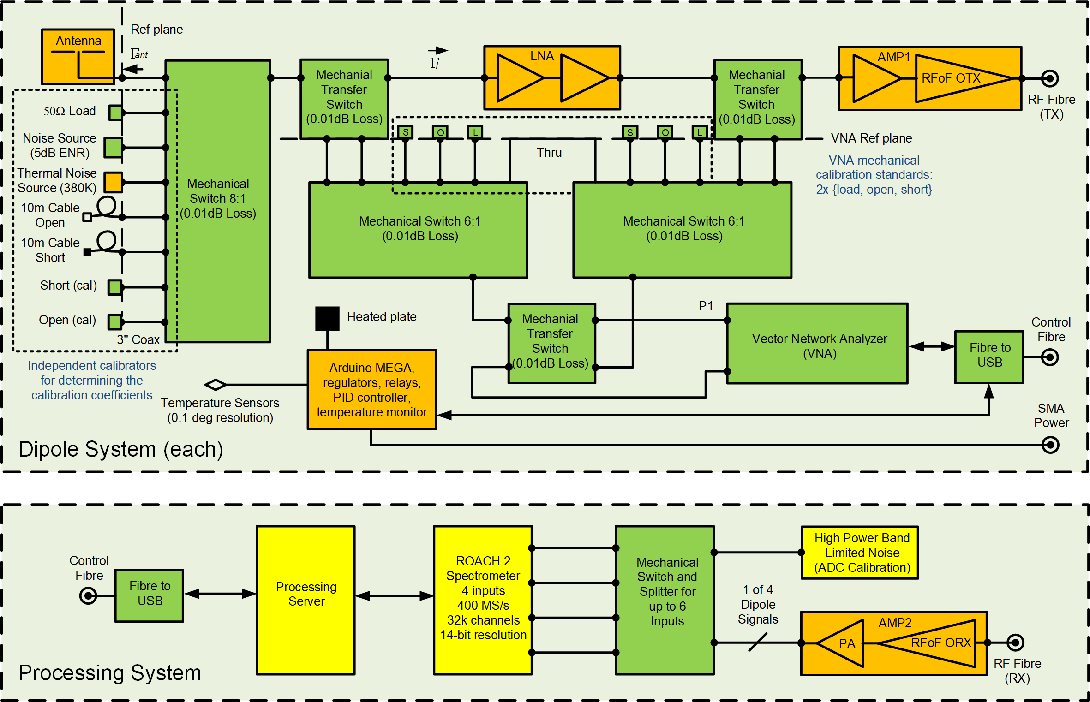
REACH Receiver
All calibration to be done in the field and relying on no lab data
Antenna, LNA/AMP1 and various source s-parameters measured with a highly accurate 2-port VNA
Input reference plane the same for antenna and other sources
Signal and control via fibre. The only galvanic connection to the receiver is power
Calibration pipeline evaluates all parameters at once
PID controller for constant temperature
RX box 50 x 50 x 20 cm

Slide 6
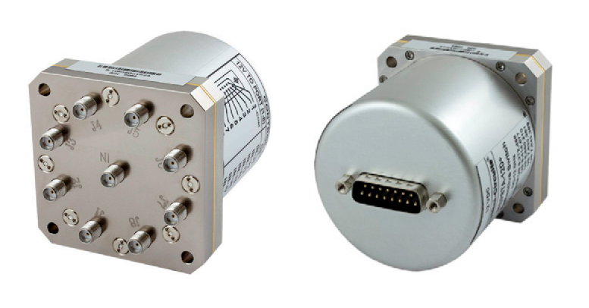
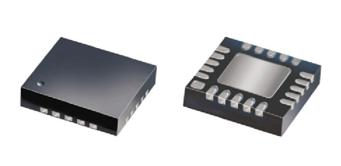
Mechanical or non-mechanical, that is the question?
Electro-mechanical switches
Long life (typ 10m operations)
Extremely low loss (0.01dB)
High isolation (typ 100+ dB)
Very good return loss (typ 40dB)
Big and bulky
Solid state switches
Very fast switching
Loss typically 0.5-1dB
Isolation typ < 60dB
Return loss typ < 20dB
Small and easy to integrate

Slide 7
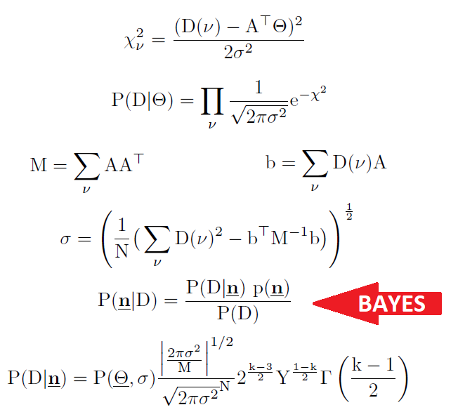
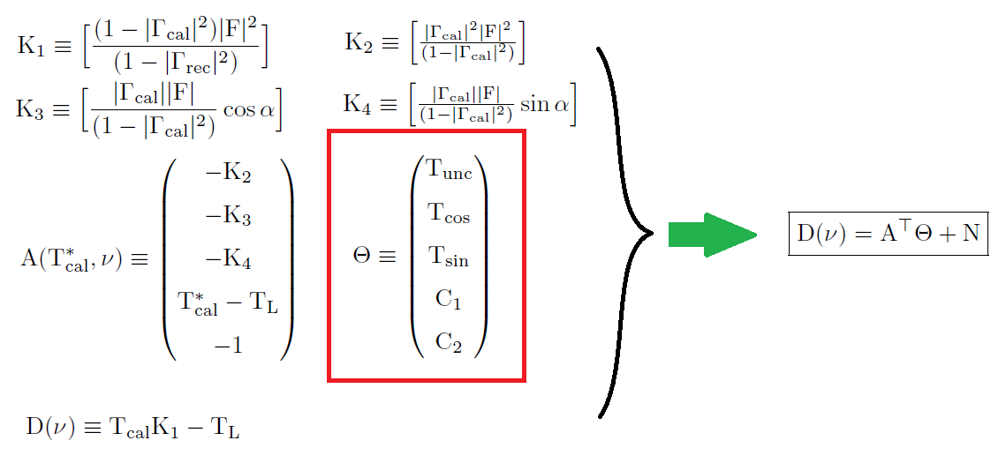
REACH Calibration pipeline
These Definitions
These Statistical Equations
Noise
# of points

Slide 8
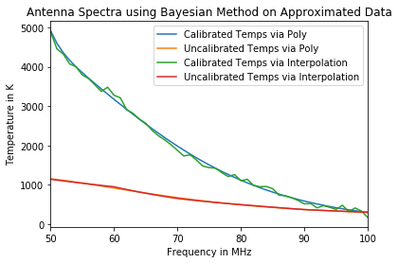
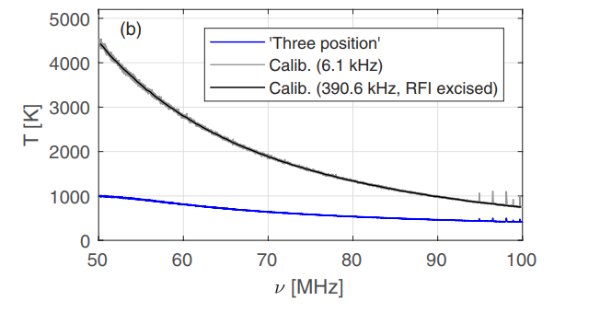
Our pipeline using EDGES estimates
EDGES Graph
Our Graph

Slide 9
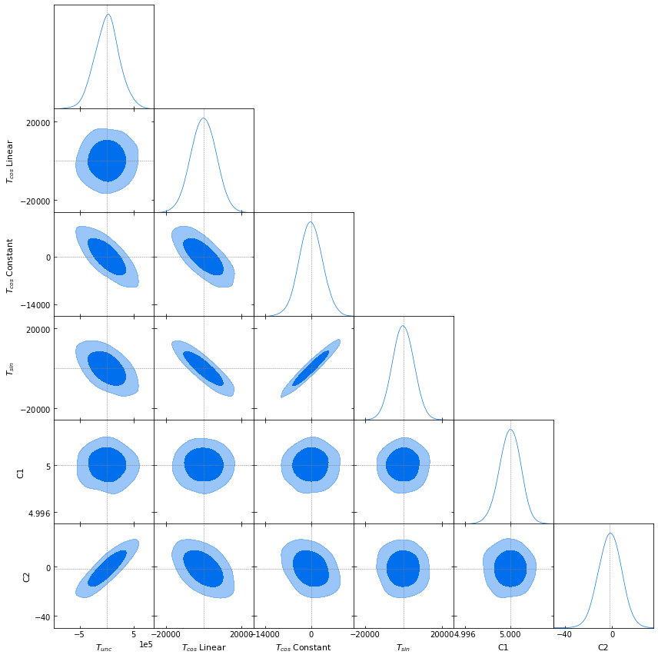
Calibration pipeline tests using measurements
Sanity Check for Ambient Load
Noise Wave Parameter Inputs:
T_{unc} |--------T_{cos}---------| T_{sin} C₁ C₂
[180, 5, -15, 10, 5, -2]
Added noise with σ = 2 using 1000 samples via GetDist
Test Linear Component
Test Constant Terms
Beginning tests for higher order terms

Slide 10
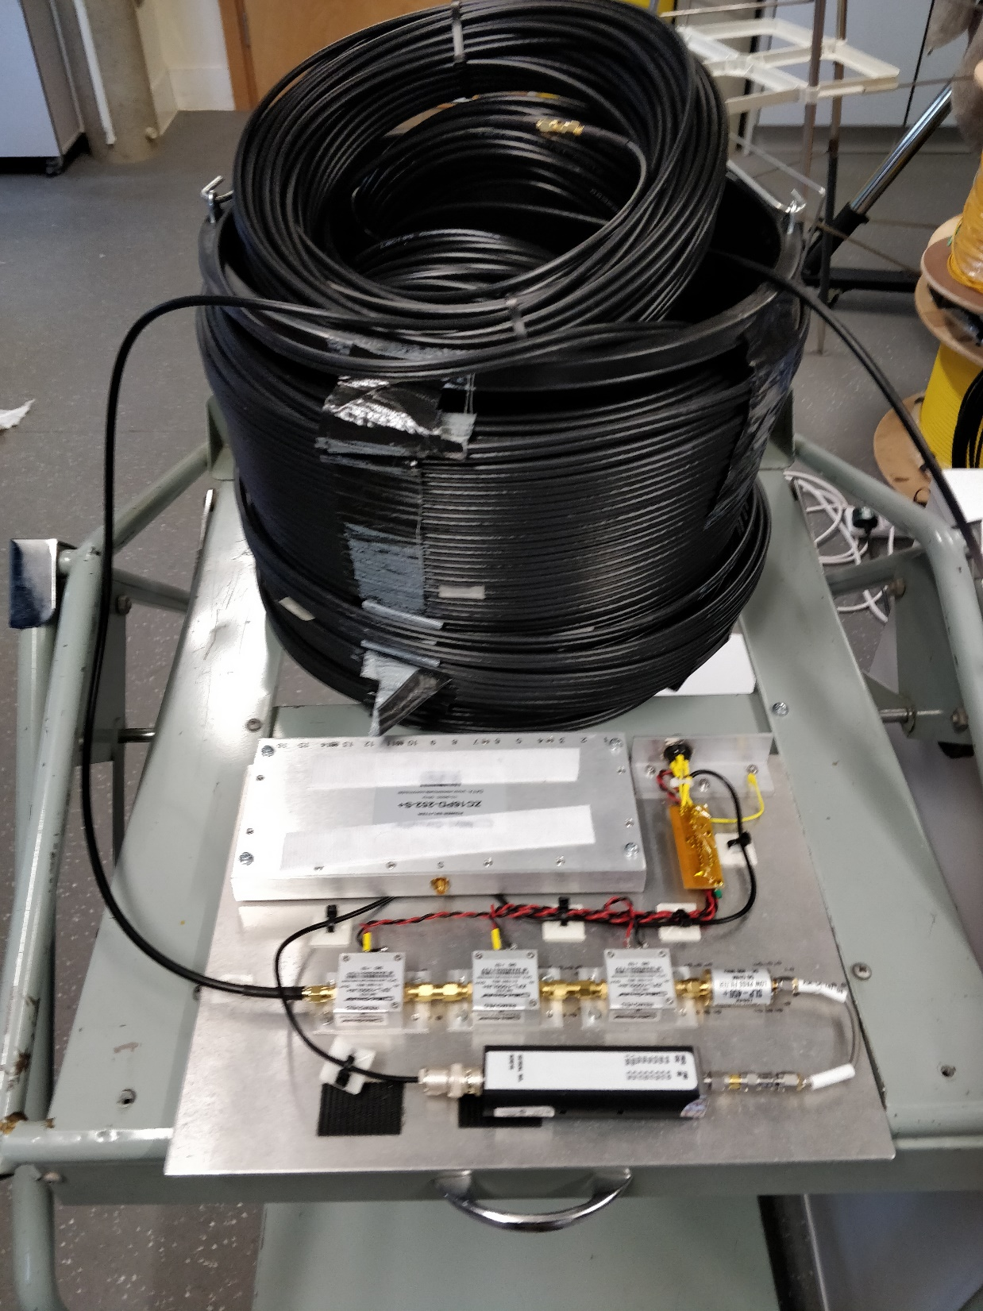
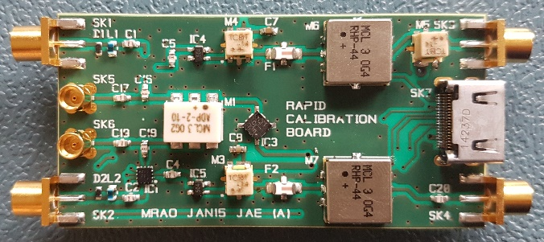
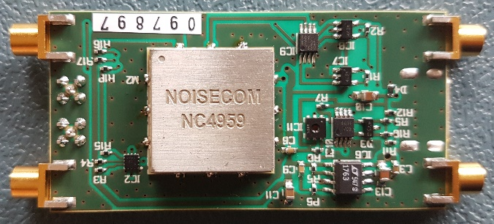
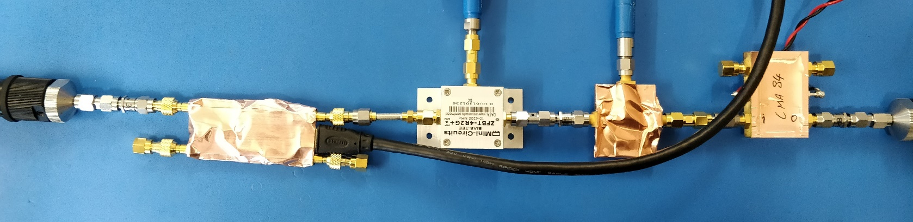
Preliminary LNA test rig currently being used

Slide 11
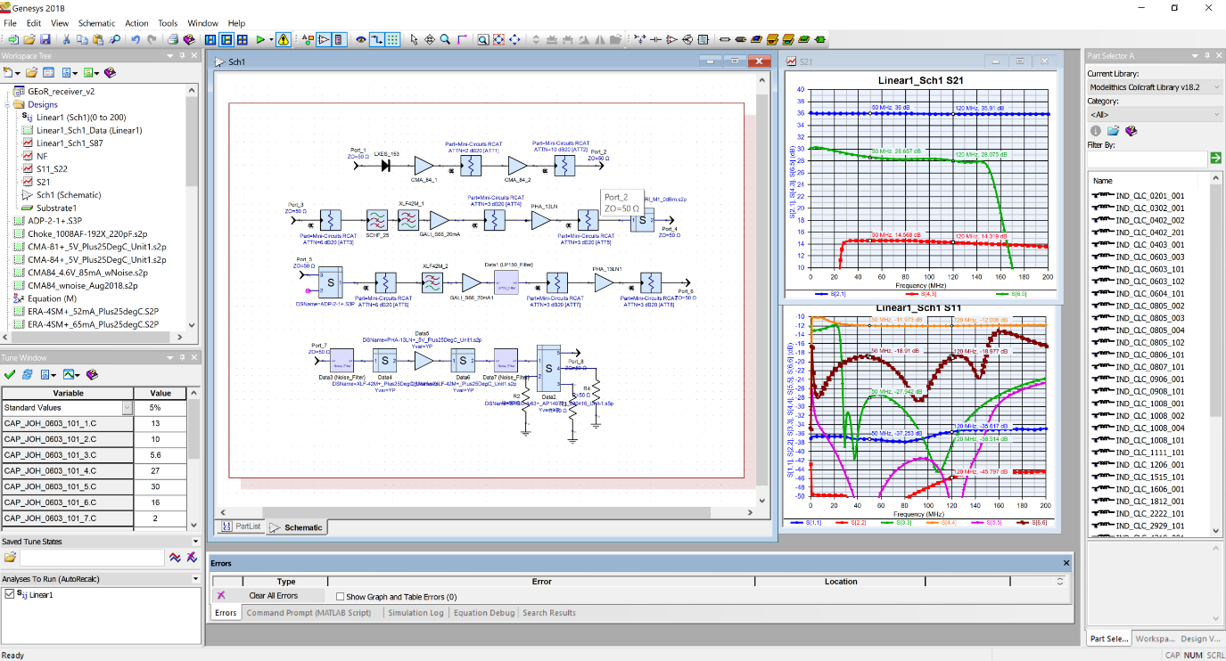
Receiver simulations in Genesys
Nitrogen filled stable first amplifier

Slide 12
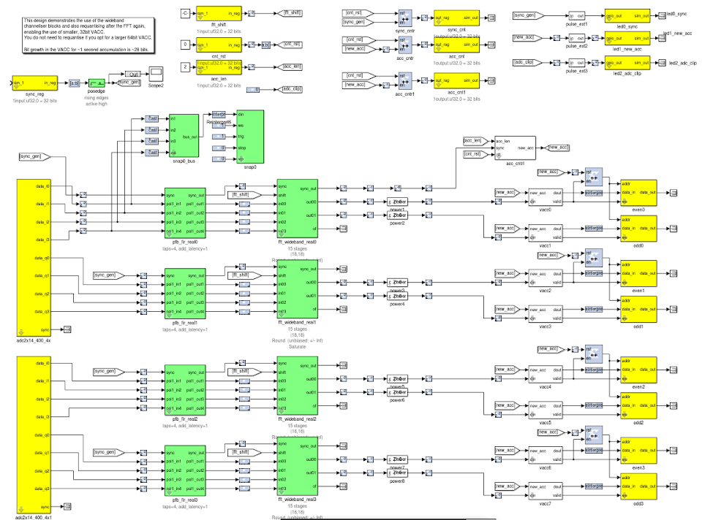
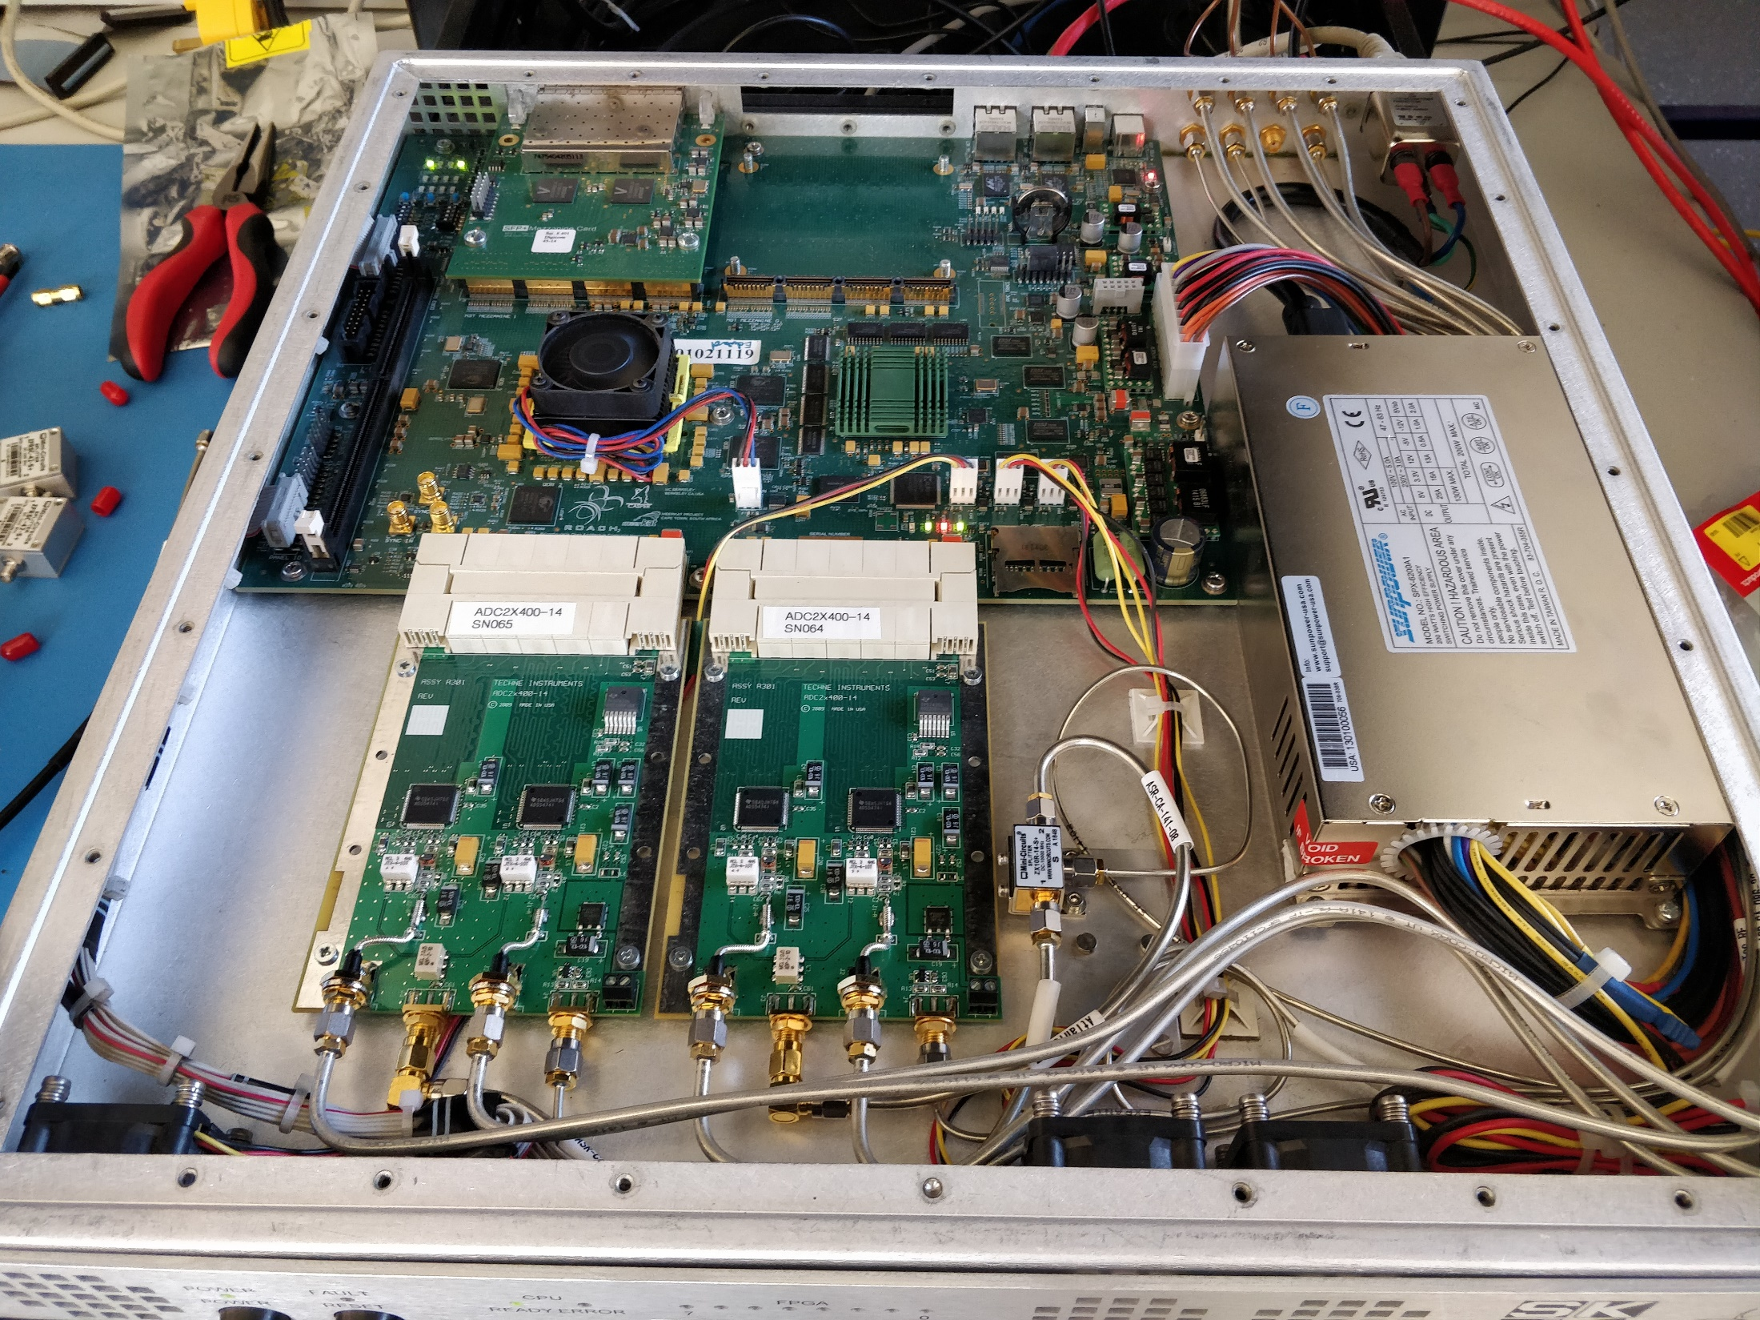
Readout and control system based on ROACH-2
4-input 16k channel (DC-200MHz) 14-bit readout system working, control system being developed

